Slide 1
UKB COVID
Interaction Analysis
Joanna Lin, Kenny Westerman,
Magdalena Sevilla, Beza Tadess

Slide 2
Background
Multiple risk factors of COVID-19 severity:
Sex
Male sex is independently associated with higher mortality and worse outcomes (Palaiodimos et al., 2020)
Cardiometabolic status
Obesity and T2D are associated with increased COVID-19 susceptibility and severity
Obesity is potentially causal with COVID-19, perhaps mediated through T2D (Leong et al., 2020)
Social determinants of health
Minoritized communities have disproportionately worse outcomes of COVID-19
They may be predisposed to worse conditions due to environmental factors, limited healthcare access, and other societal influences (Tai et al., 2020)

Slide 3
Objective
To conduct a large scale genome-wide interaction study in the UK Biobank to investigate the interaction between genetic variants and each of sex, obesity, T2D and social determinants of health in their impact on COVID-19 severity.

Slide 4
Hypotheses
Primary Hypothesis
There are genetic variants that modify the effect of known COVID-19 risk factors on COVID-19 severity (and vice versa).
Secondary Hypothesis
Incorporation of known COVID-19 risk factor interactions via a joint test can increase the power to uncover genetic loci associated with COVID-19 severity.

Slide 5
Dataset
Population: All unrelated individuals in UKB (that haven’t revoked consent)
Multi-ancestry (European, West African, East Asian, and South Asian)
Approximately 1,000 events over all ancestries
Genotypes: Largely rely on the processing already performed by the UKB group
Common variants (MAF > 0.05)
Coded as dosages
Notes:
MAF threshold higher based on initial results

Slide 6
Exposures of Interest
Genetically-determined sex
Cardiometabolic diseases
BMI as a measure for obesity
T2D (existing definition derived from the Florez lab UKB project)
Individually and jointly tested
Social determinants of health
Multiple deprivation index (metrics including: economic stability, physical environment, education)
Primarily testing MDI, then with individual metrics as sensitivity analysis
Individuals from England
Notes:
Subset to England because of heterogeneity in UK
Definitions don’t translate across different nations

Slide 7
Outcomes
Primary
COVID-19 severity defined as hospitalization
Definition based on Host Genetics Initiative Analysis “B2” - Hospitalized COVID vs Population
Secondary
COVID-19 severity defined as respiratory support or mortality
Definition based on HGI Analysis “C2” - Very severe respiratory confirmed COVID vs Population

Slide 8
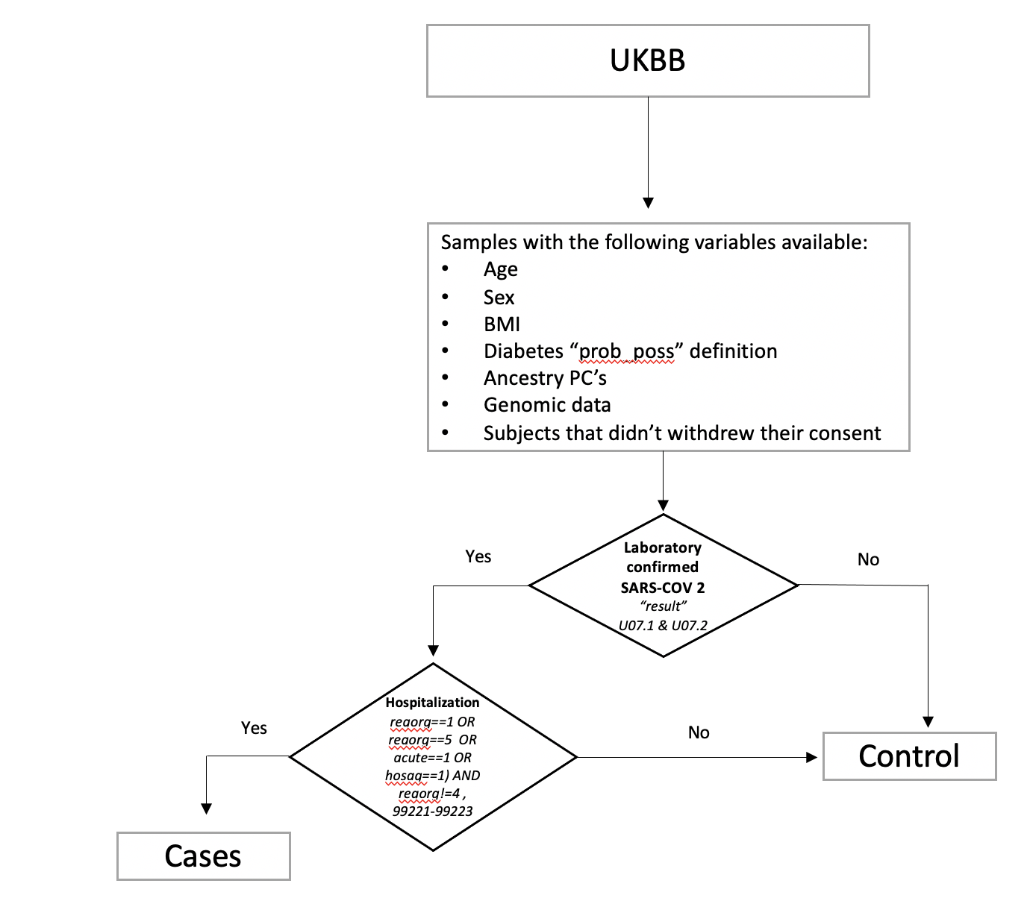
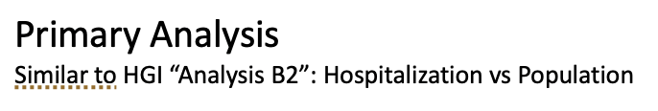

Slide 9
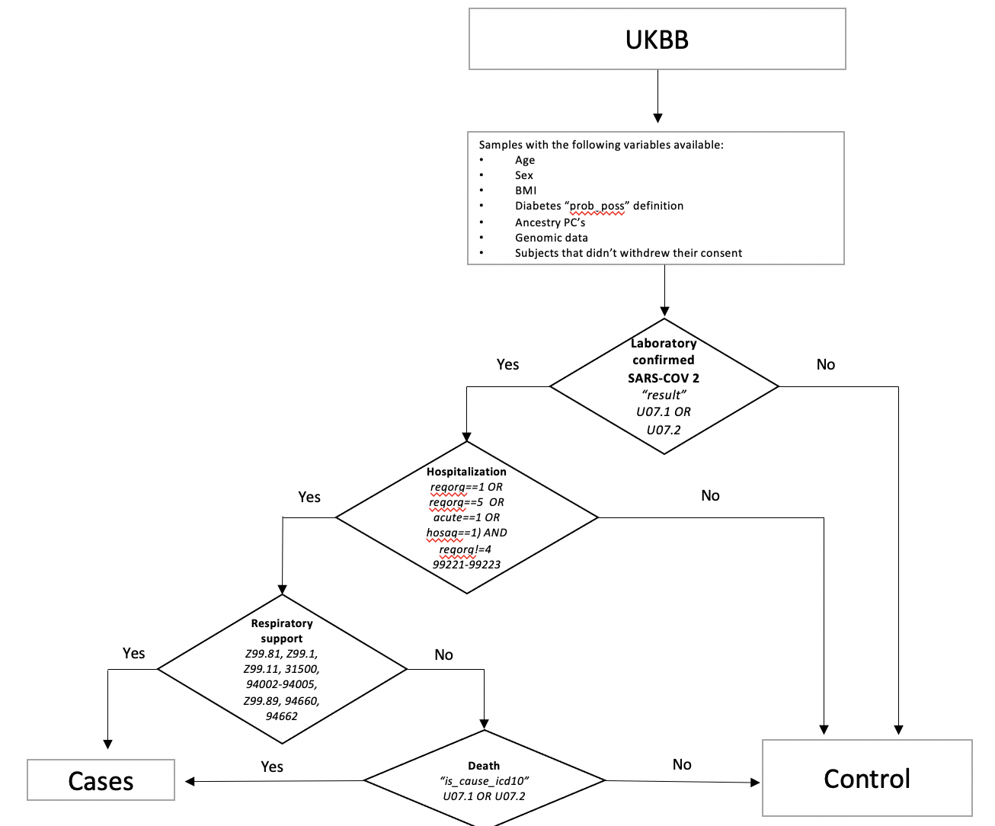
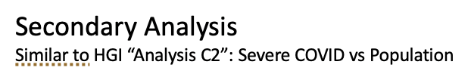

Slide 10
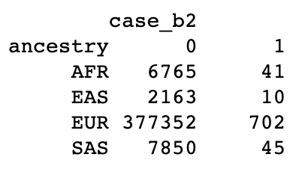
Sample sizes
Case counts similar to HGI
HGI European “B2” phenotype = 765 cases
Case variable (0=control, 1=case)
Notes:
case variable (0=control, 1=case)

Slide 11
Initial Regression Outputs
Positive controls
Exposures are associated with COVID severity (OR>1)
Exposure | Odds Ratio | P-value
SexMale | 1.5426 | 1.42E-09
BMI | 1.0499 | 1.15E-13
T2D | 2.0528 | 5.56E-10
MDI | 1.0243 | 2.33E-30
Notes:
These exposures are all associated with COVID severity (significant pvalue, odds ratio is greater than 1)

Slide 12
Statistical Methods
Linear models
y (COVID-19 hospitalization) ~ g + exposure + g*exposure + age + sex + 5 genetic PCs
Robust standard errors
Statistical tests:
Interaction test (primary)
Joint test of genetic main and interaction effect (secondary)
Ancestry stratified meta-analysis
Computational environment
Analysis to be conducted using GEM
Analysis run on Terra
Notes:
Use robust standard errors in linear models

Slide 13
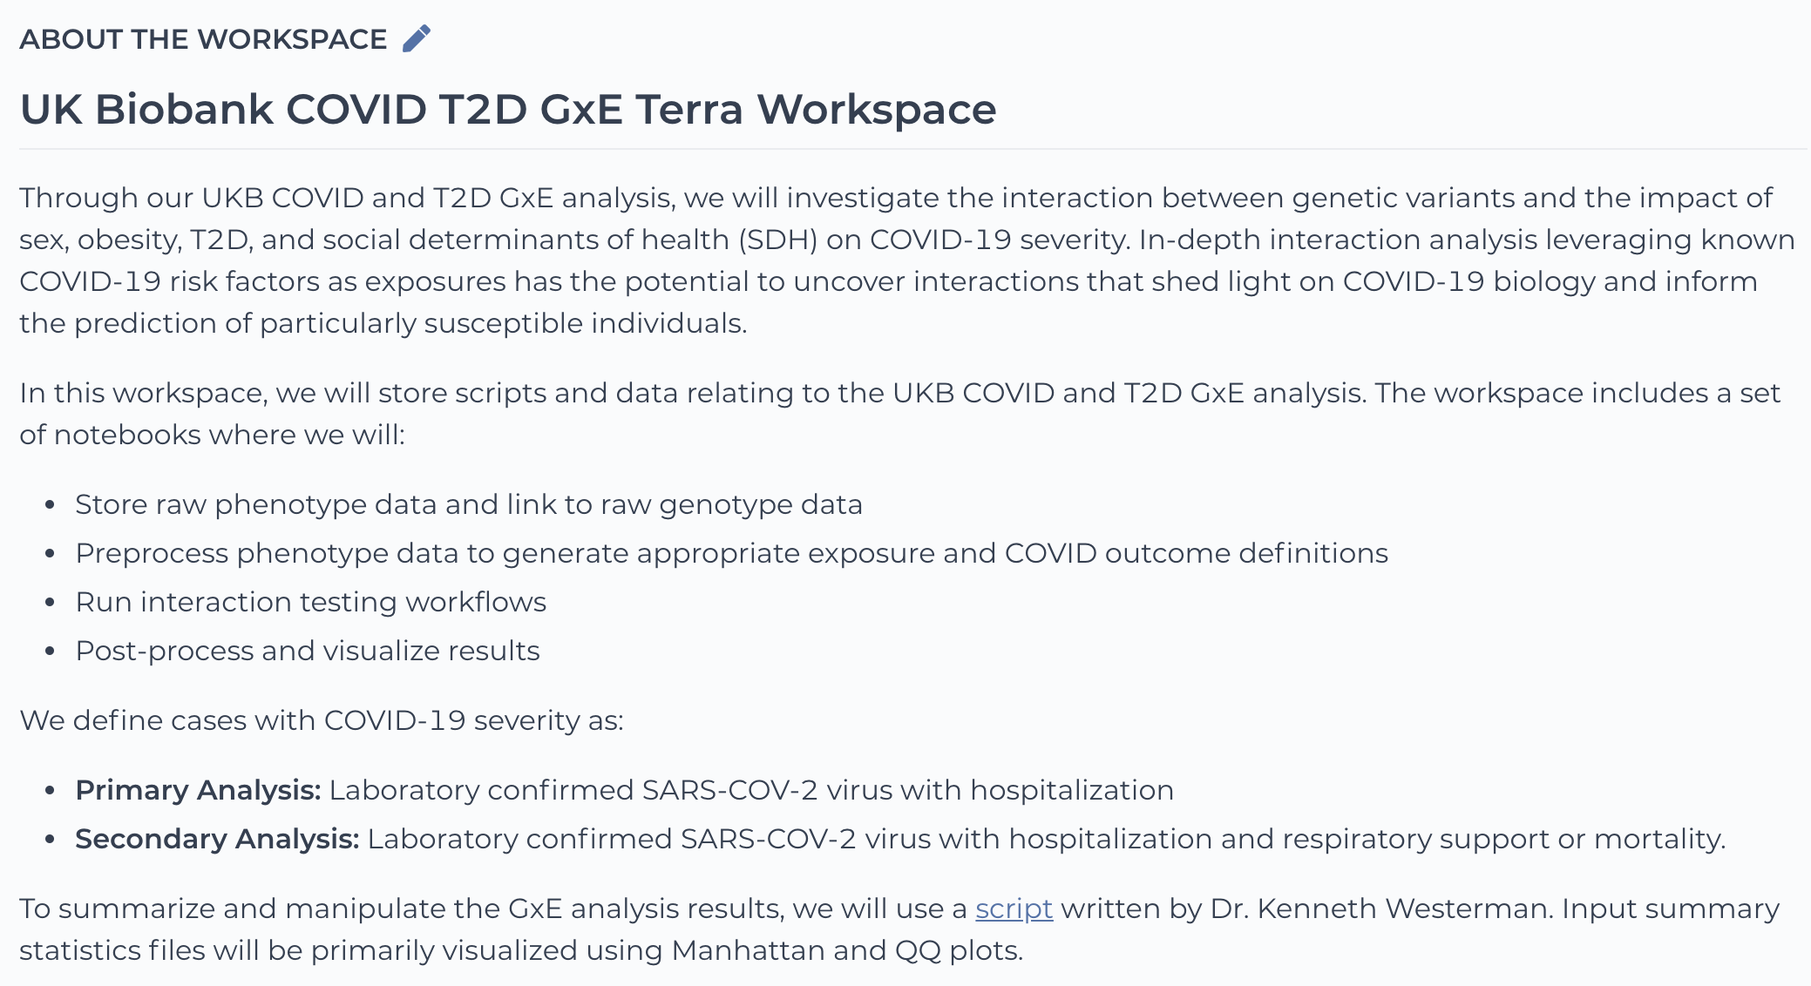
UK Biobank COVID T2D GxE Terra Workspace

Slide 14
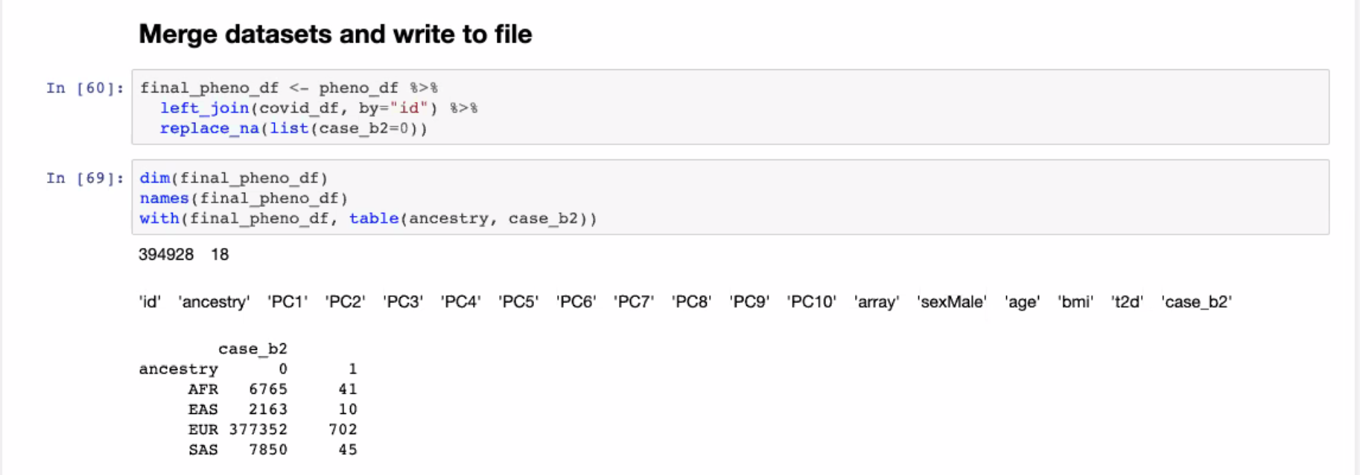
Defining Phenotype Files
Based on ID, ancestry, principle components, sex, age, cardiometabolic disease, and case variable (0=control, 1=case)

Slide 15
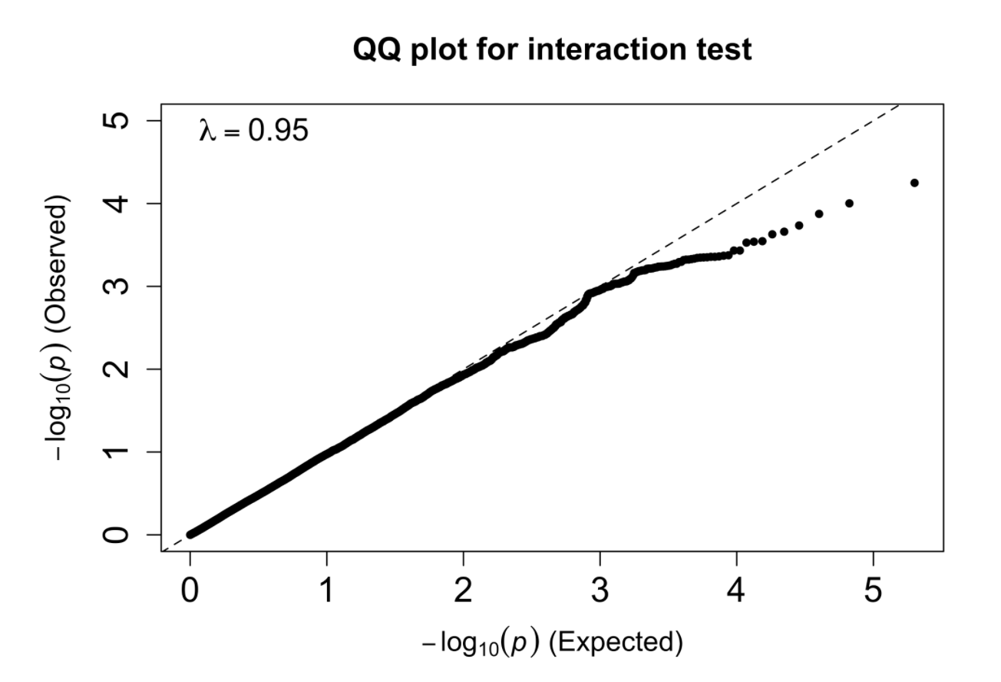
Preliminary Analysis Results - GxSex in Chr 22
Testing for false positives
Some deflation

Slide 16
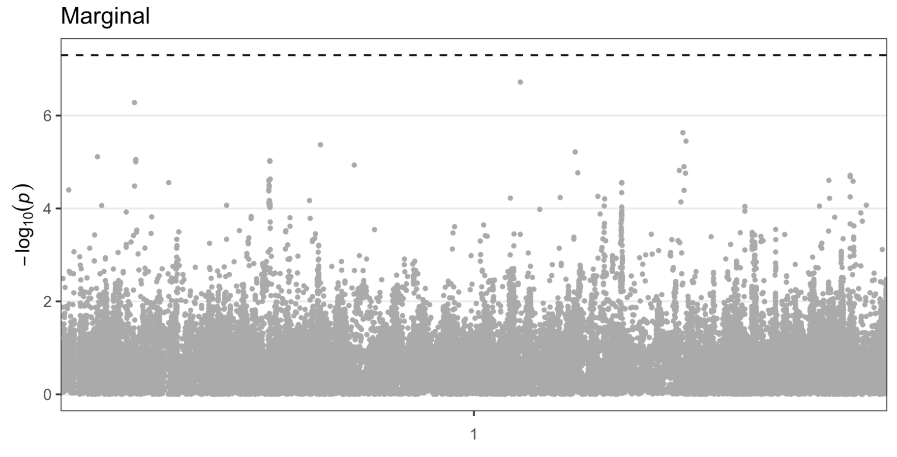
GxSex in Chr 22 - Marginal Manhattan Plot
Notes:
Marginal = genetic effect
Is this variant associated with being a case

Slide 17
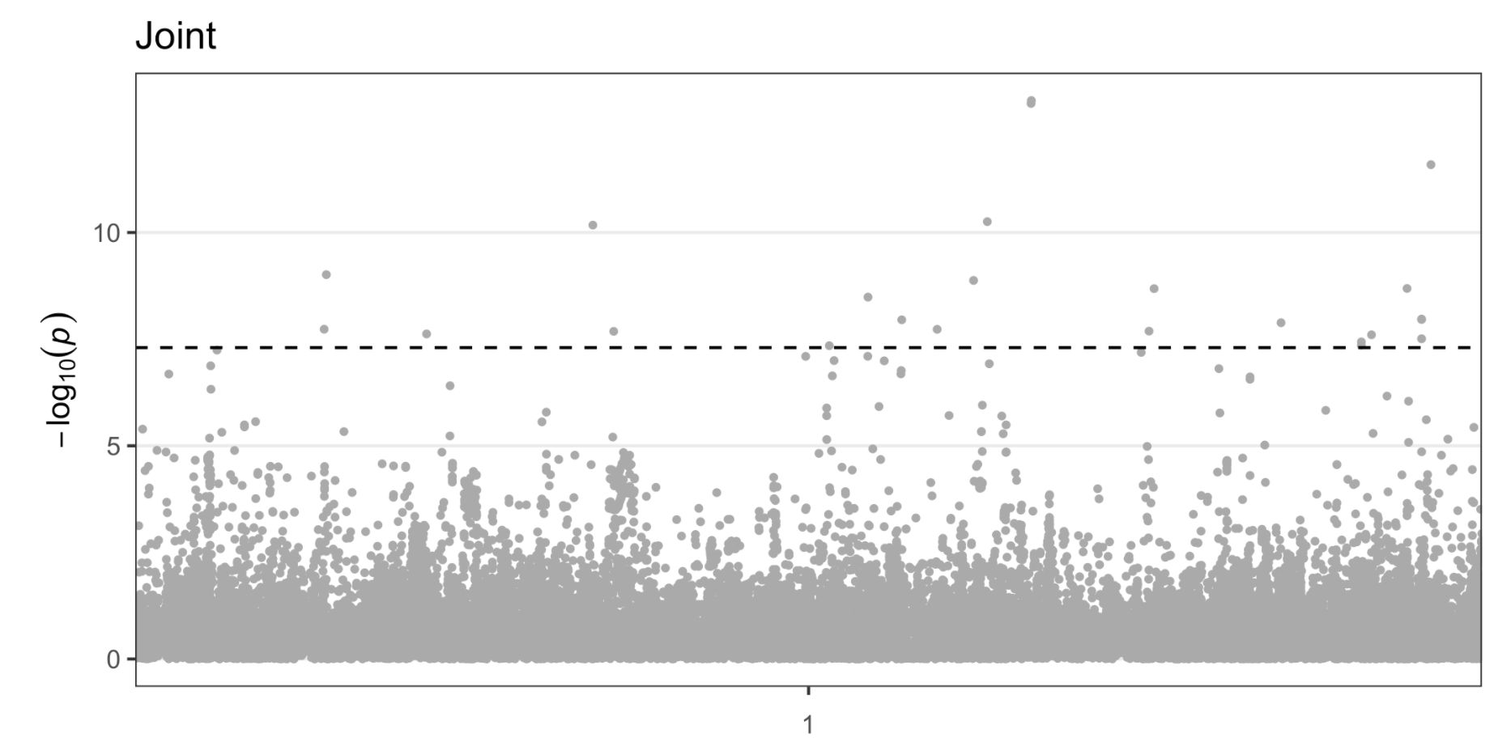
GxSex in Chr 22 - Joint Manhattan Plot
Notes:
variants that are associated with being a case
Skeptical of joint effects due to case control imbalance (1:300)
Lower-freq variants causes these joint effects
Downsampling control set (1:10?)
MAF filter >0.05 (minor allele frequency)

Slide 18
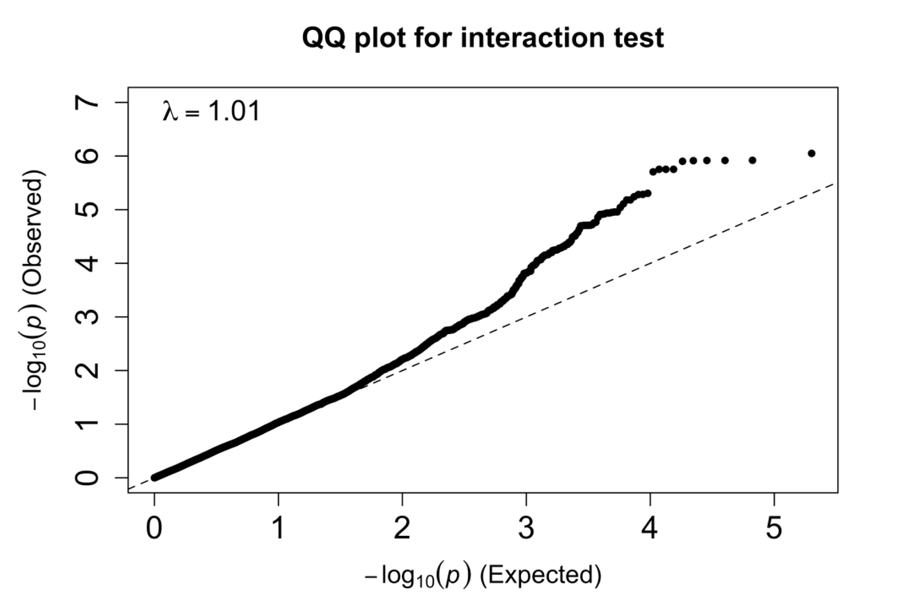
Joint Cardiometabolic (T2D and BMI)
Minor inflation
Some proportion of p-values are more than significant
Small lambda value
Possibly confounders

Slide 19
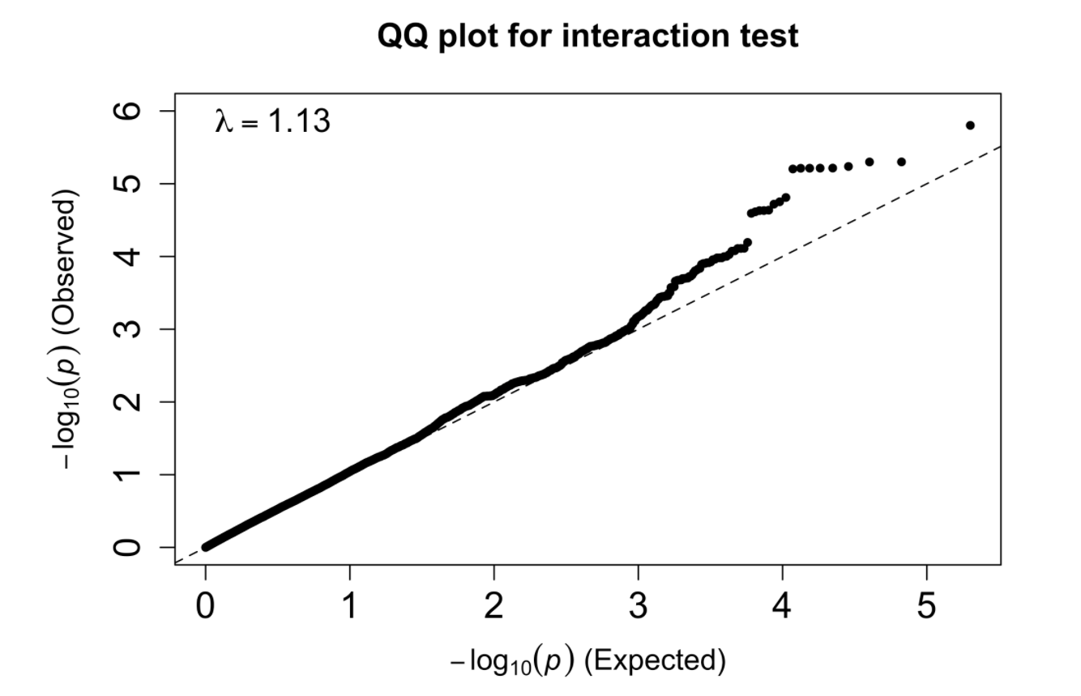
Multiple Deprivation Index
Minor inflation
Lambda is not as close to 1

Slide 20
Preliminary Analysis Results
Reasonable findings
Questions about lower-frequency variants causing joint effects
Results are likely skewed due to case-control imbalance
Will continue with joint interaction tests and conduct genome-wide analyses

Slide 21
Next steps
Run genome-wide analyses for all exposures and ancestries
Manuscript
Proposed (Aggressive) Timeline:
December - finish non-SDH analysis + refine background/methods
January - complete SDH analysis
February - write results + discussion
March - submit paper :)

